Slide 1
Comparative Analysis between Singapore & Hong Kong
Chan Kok Siang
26 May 2020

Slide 2
Agenda
Introduction
Data Sources
Methodology
Results
Learnings

Slide 3
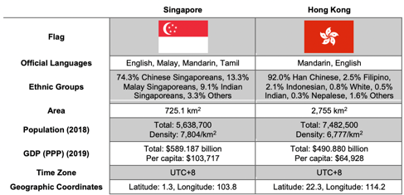
Introduction
Background
Singapore and Hong Kong have often been associated with one another.
Travellers often compare their neighbourhoods, shopping belts and CBDs.
Comparisons can vary widely depending on individual’s experience and inclinations.
Problem
Analysis done at individual’s level can be subjective.
Analysis can be limited in scope since it is atypical for an individual to travel to all areas in both cities.
Interested Parties
People who are planning to visit in near future.
People who are finding districts with certain amenities and facilities to stay.

Slide 4
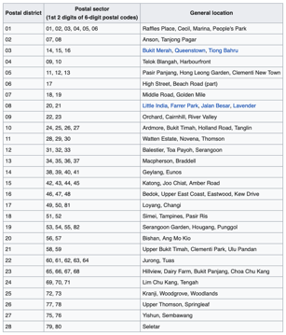
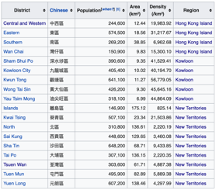
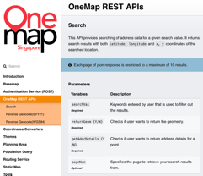
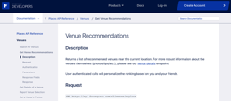
Data Sources
OneMap REST API on Search (source: OneMap)
Hong Kong Districts (source: Wikipedia)
Singapore Postal Districts (source: Wikipedia)
Foursquare Places API on Explore (source: Foursquare)

Slide 5

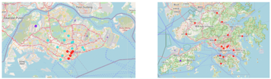



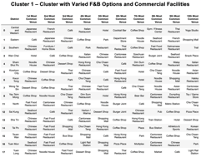


Methodology
Step 1 - Dataframe Creation
Step 3 - District Clustering
Based on k-means clustering and elbow method to find optimal k
Step 2 - Coordinates Addition
... and more clusters

Slide 6
Results
Singapore | Hong Kong
Cluster 1 – Cluster with Commercial Facilities and Multinational F&B Options | Cluster 1 – Cluster with Varied F&B Options and Commercial Facilities (Note: This cluster appears to be an amalgamation of Singapore’s Clusters 1, 3 and 4.)
Cluster 3 – Cluster with Residential Facilities and More Individual-Themed Restaurants (i.e. more matured estates, closer to CBD)
Cluster 4 – Cluster with Residential Facilities and More Commoditised F&B Options (less matured estates, further away from CBD)
Cluster 2 – Cluster with Nature-Themed Facilities (outlier) | Cluster 2 – Cluster with Nature-Themed Facilities (outlier)
Nil | Cluster 3 – Cluster with Suburban Facilities & Transport Hub (outlier)

Slide 7
Learnings
Data preparation took more time than expected. Allocate more time for this task for future data science projects.
Data retrieval from online resources was not always ideal. Store retrieved data in a persistent format for subsequent read operations.
Current analysis leveraged limited features during clustering process. Include additional features to improve clustering results.
Standard search radius was used for Foursquare API on Explore. Use specific search radius for each district to increase accuracy of search results.

